Slide 1
Ambient air pollution and health outcomes in pediatric hematology & oncology
Paul George, MD
Senior Associate, Pediatric Hematology/Oncology
PhD Candidate, Health Policy and Management (health economics focus)
AiR Presentation, May 2024

Slide 2
Overview
Project 1. Air pollution and sickle cell disease
Project 2. Air pollution and pediatric cancer

Slide 3
Project 1: Air pollution & sickle cell disease

Slide 4
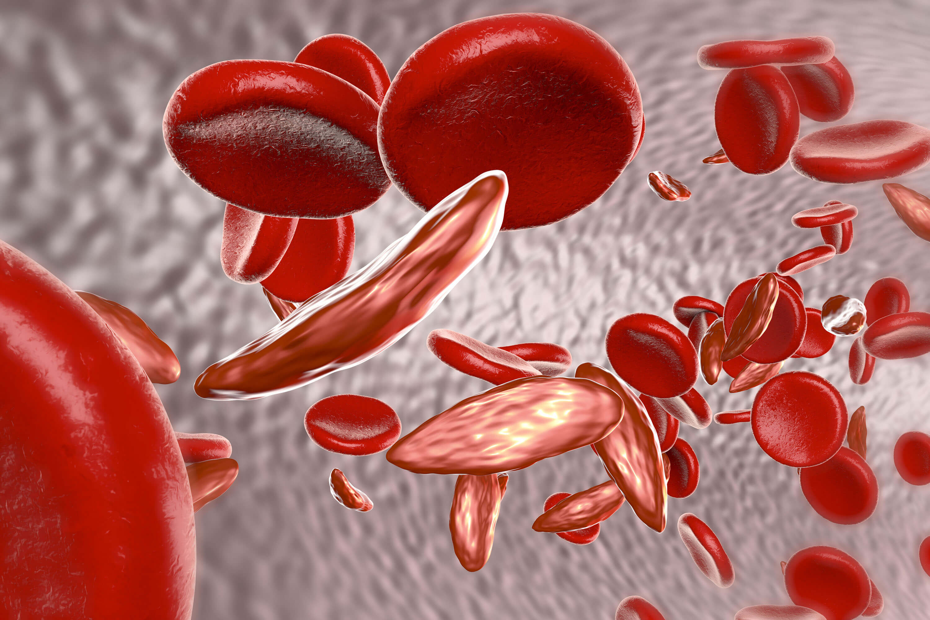

Pediatric sickle cell disease remains associated with severe morbidity and mortality
~100,000 Americans have sickle cell disease (SCD)
SCD is phenotypically variable
Notes:
100,000 Americans have sickle cell disease, a monogeneic disorder that causes RBCs to sickle, leading to many downstream health consequences.
As we know, despite being a monogenic disease, it’s phenotypically quite variable.

Slide 5




Phenotypic variability & risk factors for severe disease

Slide 6
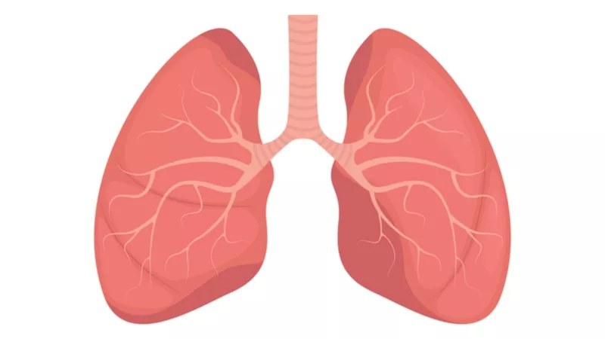

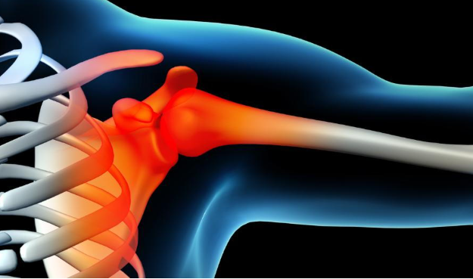

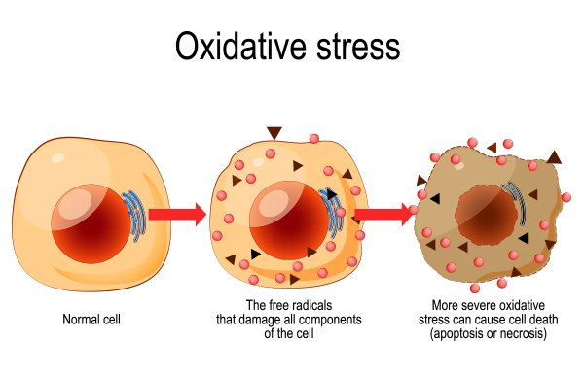
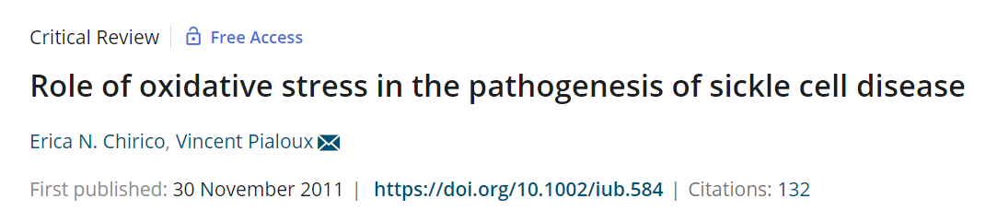
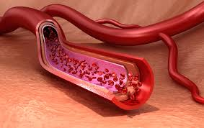

Pathophysiology of air pollution

Slide 7
Data sources

Slide 8

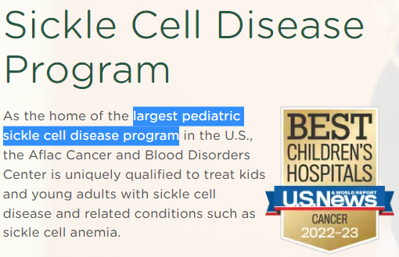
Large cohort of children with SCD
Patient data abstracted from Children’s Healthcare of Atlanta Clinical SCD Database
Notes:
Clinical, sociodemographic, and laboratory information children with SCD

Slide 9

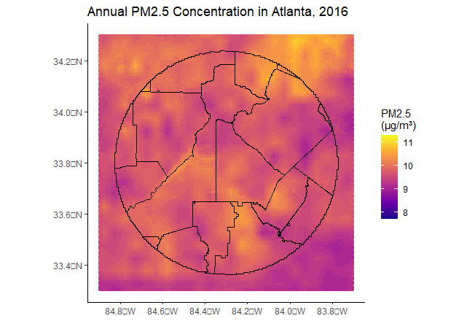
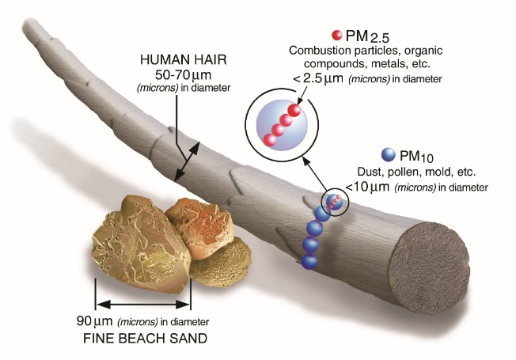

Granular air pollution data
Air pollution data extracted from NASA Socioeconomic Data and Applications Center (SEDAC).
Sources: www.clarity.io/blog/, www.epa.gov/pm2.5
Notes:
This air pollution data from SEDAC is obtained by combining NASA satellite imagery with air pollutant data from on the ground EPA monitoring stations, thereby providing daily air pollution levels in 1 km x 1 km grids across the United States.

Slide 10
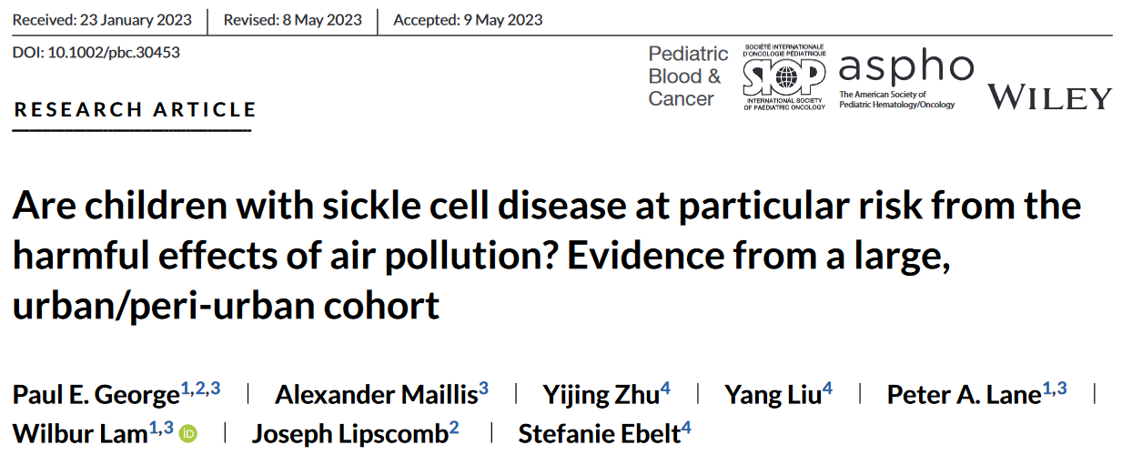
Previous work
Higher concentrations of daily ambient air pollution is associated with more ED visits in a cohort of children with SCD.
Notes:
Most ubiquitous environmental risk factor

Slide 11
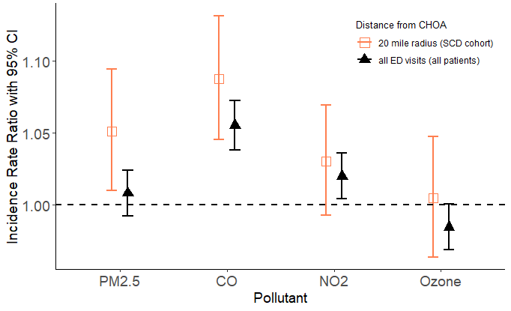
Air pollution levels are positively associated with ED visits
Association of daily pollutant levels with emergency department visits
p = 0.001
SCD cohort
Non-SCD cohort
p = 0.015
p = 0.114
p = 0.820
Notes:
This graph gives the results of the main model, which compares PM2.5 levels to ED visits in the cohort of children with SCD.
Supports the hypothesis that PM2.5 is associated with ED visits.
But, if you’ll recall, I also stated that, because of the pathophysiology of both SCD and air pollution, kids with SCD would be especially impacted by air pollution.
In order to test that hypothesis, we performed a comparison analysis in which we looked at all ED visits across the 3 CHOA EDs, subtracting out visits by children with SCD, and then ran the same model, to obtain associations of ED visits with air pollutant levels for children without SCD.

Slide 12
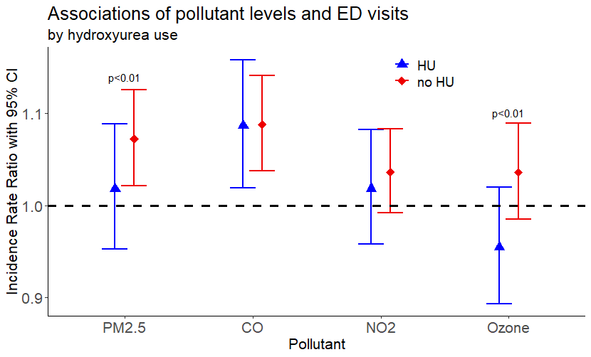
Those on hydroxyurea are less impacted by increases in daily air pollution
Notes:
When dividing the group into those taking hydroxyurea vs. not, those on hydroxyurea are less impacted by increases in daily air pollution. In other words, in this analysis, taking HU seems to mitigate the harms from exposure to daily increases in air pollution exposure.

Slide 13
Limitations and next steps
Limitations
Cohort-wide
Acute, not chronic
Model development
Solutions
Individual
Long-term
Notes:
The work is not done. The project I just described is cohort-wide analysis, so I couldn’t evaluate individual variables, such as sociodemographic status or medication use. Also, I only looked at acute increases in air pollution as opposed to the chronic burden, which may be more important in children with a chronic inflammatory disease like SCD.

Slide 14
Individual-level, long-term project

Slide 15
Hypothesis
We hypothesize that, after accounting for key confounders, PM_{2.5} levels at an individual’s home address will be significantly associated with poor clinical outcomes and higher markers of inflammation.
We hypothesize that hydroxyurea use, due to its anti-inflammatory properties, will act as an effect modifier and mitigate the harms caused by air pollution exposure.

Slide 16
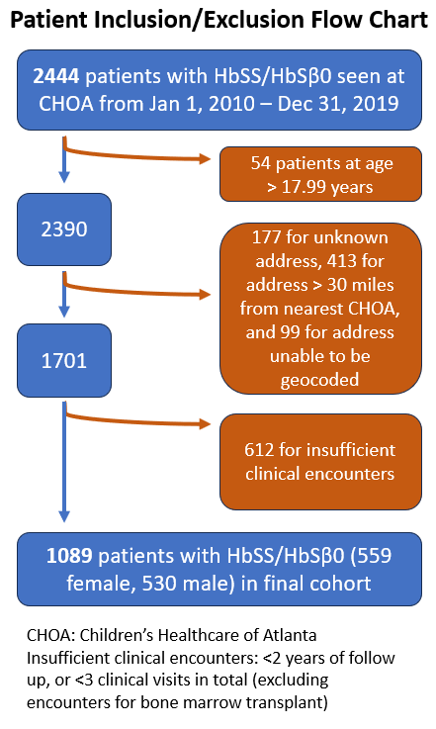
Study population

Slide 17
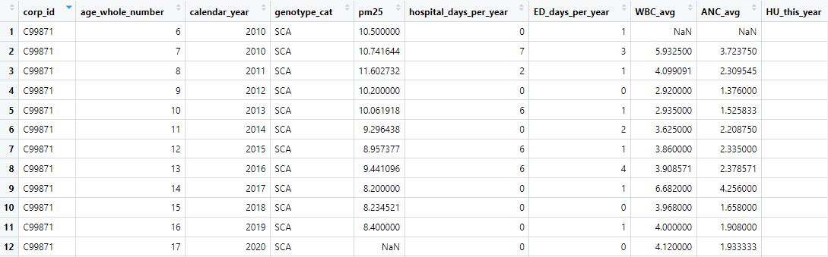
Panel dataframe with annual values
Notes:
Because our exposure of interest is annual PM2.5 values, we had combined our covariates/confounders of interest and our outcomes of interest into annual values.

Slide 18
Statistical models

Slide 19
Fixed effects models
Main outcome variables: per person per year
number of hospital days per person per year (count – quasi-Poisson)
average WBC, ANC, hemoglobin (baseline) per person per year (continuous – linear)
abnormal stroke risk screening per person per year (binary – logistic)
Fixed effect: individual fixed effect
Statistical technique, commonly used in health economics, to control for unobserved individual differences by comparing each person’s outcome over time to their own average value
Isolates the effects of time-varying factors (e.g., pollution)
Controls for time-invariant factors (e.g., sex, genetics, baseline characteristics)
Notes:
I want to understand how air quality, and specifically how changes in air quality, affects the health of patients over time. However, one challenge is that each individual patient is unique – some might be naturally healthier for reasons that we can’t always measure, for example, genetic predispositions, childhood experiences, are you born into a family with a lot of resources, or without a lot of resources? These individual, time-invariant, factors can confound the relationship we are looking at, in this case, the impact of air pollution on health outcomes. A fixed effects model, in essence, helps us focus specifically on what changes for each person over time, and this fixed effect is statistically quite powerful because it accounts for, or controls for, all factors unique to each person that do not change across time (which, for patients with SCD, includes relevant variables such as genetics (alpha thal), any baseline health characteristics, family health values).

Slide 20
OLS
x
x
x
x
x
x
x
x
x
x
x
x
x
x
Outcome variable
x
x
x
x
x
x
x
x
x
x
x
x
x
x
x
Exposure variable

Slide 21
x
x
x
x
x
x
x
x
x
x
x
x
x
x
Outcome variable
x
x
x
x
x
x
x
x
x
x
x
x
x
x
x
Exposure variable
Notes:
Now, imagine instead of totally independent data points, we instead have data that is grouped by individual. Here, each unique color represents a unique individual. So, a fixed effect, a fixed effect for each individual, accounts for the fact that observations among individuals are likely related. And if we account for the fact that observations among individuals across time are related, then we can see a different relationship emerge.

Slide 22
x
x
x
x
x
x
x
x
x
x
x
x
x
x
Outcome variable
x
x
x
x
x
x
x
x
x
x
x
x
x
x
x
Exposure variable
Notes:
Now, imagine instead of totally independent data points, we instead have data that is grouped by individual. Here, each unique color represents data from a unique individual. So, a fixed effect, a fixed effect for each individual, accounts for the fact that observations among individuals are likely related. And if we account for the fact that observations among individuals across time are related, then we can see a different relationship emerge. So, in order to use a fixed effect like this, you need some way to group the data. So, because we have this great SCD dataset that follows individuals across time, a panel dataset, I can use a fixed effects model here. And shown in this example, the modeling strategy that you use can have an important impact on the relationship you measure.

Slide 23
Fixed effects models
Main outcome variables: per person per year
number of hospital days per person per year (count – quasi-Poisson)
average WBC, ANC, hemoglobin (baseline) per person per year (continuous – linear)
abnormal stroke risk screening per person per year (binary – logistic)
Fixed effect: individual fixed effect
Statistical technique, commonly used in health economics, to control for unobserved individual differences by comparing each person’s outcome over time to their own average value
Isolates the effects of time-varying factors (e.g., pollution)
Controls for time-invariant factors (e.g., sex, genetics, baseline characteristics)
Main exposure: annual PM_{2.5} levels at each person’s home address for a given year of age
Using the SEDAC data
Interaction term: statistical method to determine if hydroxyurea (HU) changes the impact of air pollution
Time-varying covariates: neighborhood SES, insurance, distance from nearest hospital, yearly temperature

Slide 24
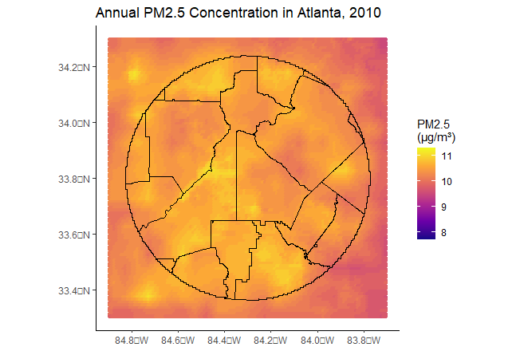
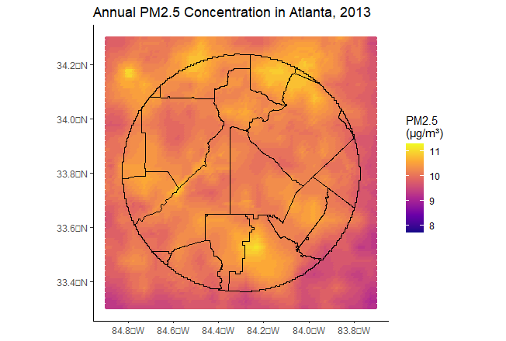
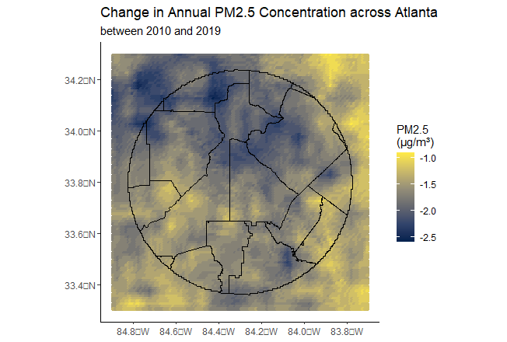
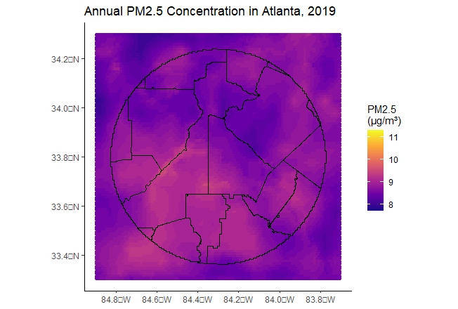
PM_{2.5} in Atlanta, 2010-2019
Annual PM2.5 Standards
EPA (US): 12 → 9 µg/m³
WHO: 5 µg/m³
Notes:
Where does the variation in PM2.5 come from? 1. changes across time. 2. changes across place. Values for reference.

Slide 25
Results

Slide 26
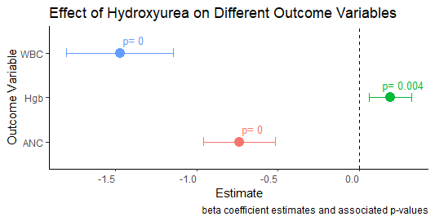
Results – model check(s)

Slide 27
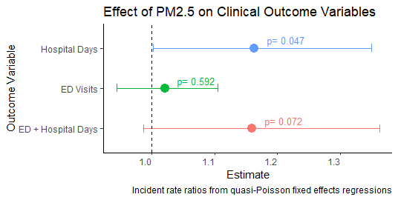
Results – clinical outcomes
Outcome | Result
Hospital days (count) | +
ED visits (count) | NS
ED + hospital days | NS
Annual PM2.5 Standards
EPA (US): 12 → 9 µg/m³
IRR 36.5%
Notes:
IRR of 1.16 means that for every unit increase in PM2.5, we would expect an increase in the rate of hospital days of 16%, holding all else equal.
To put this in perspective, in February 2024, the EPA reduced the annual PM_{2.5} National Ambient Air Quality Standard from 12 to 9 µg/m³;(31) in the context of our fixed effects Poisson regression model, a reduction of PM_{2.5} of this magnitude would be associated with an expected decrease in the incidence rate of hospital days by 36.5% for a child whose baseline PM_{2.5} exposure is 12 µg/m³.

Slide 28
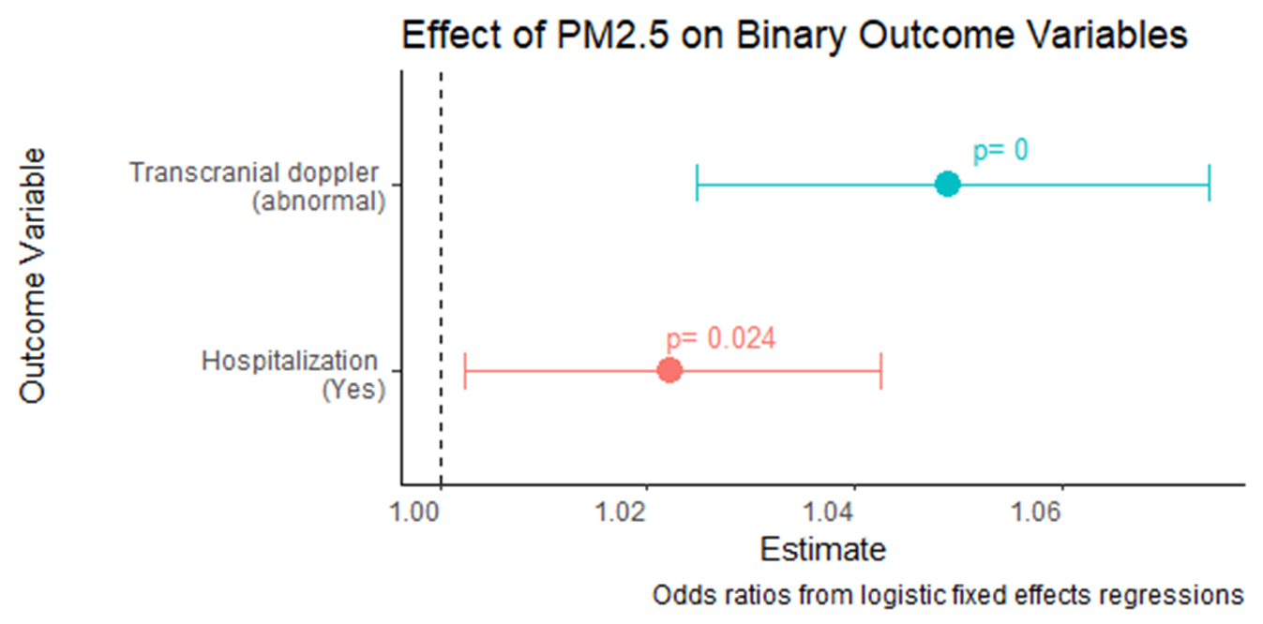
Results – clinical outcomes
Outcome | Result
Hospital days (count) | +
ED visits (count) | NS
ED + hospital days | NS
TCD (abnormal) | +
Hospitalization (yes) | +
Notes:
An odds ratio of 1.05 means that for every unit increase in PM2.5, the odds of the likelihood of an abnormal transcranial doppler is increased by 5%.

Slide 29
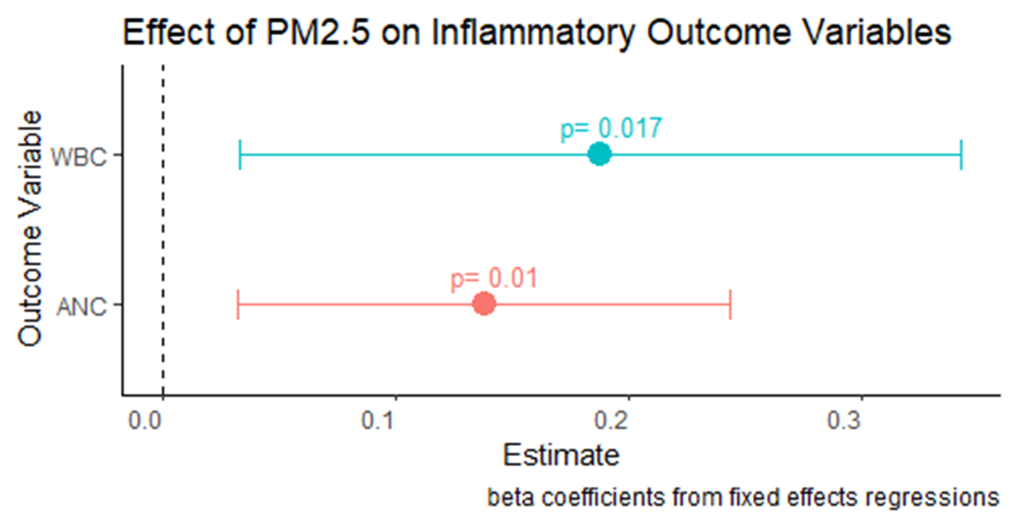
Results – laboratory outcomes
Outcome | Result
Hospital days (count) | +
ED visits (count) | NS
ED + hospital days | NS
TCD (abnormal) | +
Hospitalization (yes) | +
WBC | +
ANC | +

Slide 30
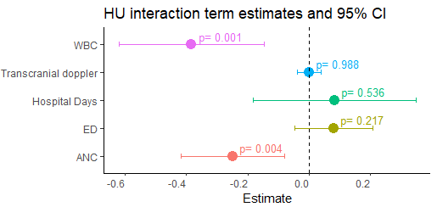
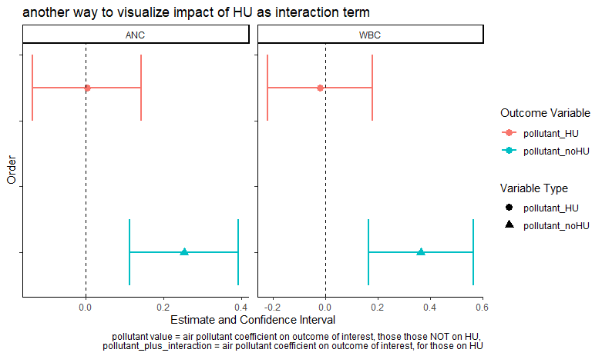
Results – interaction term
Notes:
Results of HU and pollution interaction term. So this tells us, does being on hydroxyurea change the effect that PM2.5 has on the various outcomes? And what I’m showing here, is for TCD, hospital days, and ED visits, there is no significant effect. So being on HU doesn’t change the impact that PM2.5 has. However, for WBC and ANC, we see there is a significant, negative effect. So what we are seeing is that HU seems to protect against the increases in WBC and ANC that are associated with PM2.5 exposure. Which goes with what we know about HU, that it has anti-inflammatory properties.

Slide 31
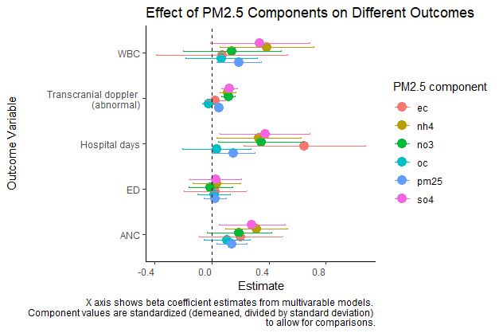
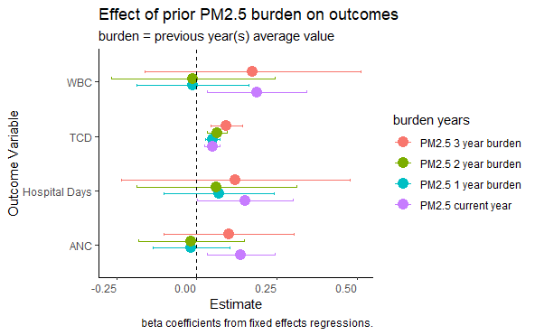
Results – other

Slide 32
Summary of findings
PM_{2.5} concentrations, at an individual’s home address, are positively associated with:
hospital days per year for the individual,
likelihood of any hospitalization,
likelihood of abnormal TCD screen,
WBC and ANC.
Hydroxyurea use mitigates the increases of WBC and ANC that are associated with PM_{2.5} exposure, but hydroxyurea use does not change the effect of PM_{2.5} on hospital days or abnormal TCD.

Slide 33
Project 2: Air pollution & pediatric cancer

Slide 34




Pathophysiology of air pollution

Slide 35
Data sources

Slide 36
Granular air pollution data
Air pollution data extracted from NASA Socioeconomic Data and Applications Center (SEDAC).
Sources: www.clarity.io/blog/, www.epa.gov/pm2.5
Notes:
This air pollution data from SEDAC is obtained by combining NASA satellite imagery with air pollutant data from on the ground EPA monitoring stations, thereby providing daily air pollution levels in 1 km x 1 km grids across the United States.

Slide 37

Patient data
NCBD is a clinical oncology database, sources from hospital registry data collected in >1,500 Commission on Cancer-accredited facilities
American College of Surgeons + American Cancer Society
~70% of all newly diagnosed cancer cases in the United States
Cancer type, date of diagnosis, zip code at time of diagnosis, vital status (alive vs deceased) at last contact

Slide 38
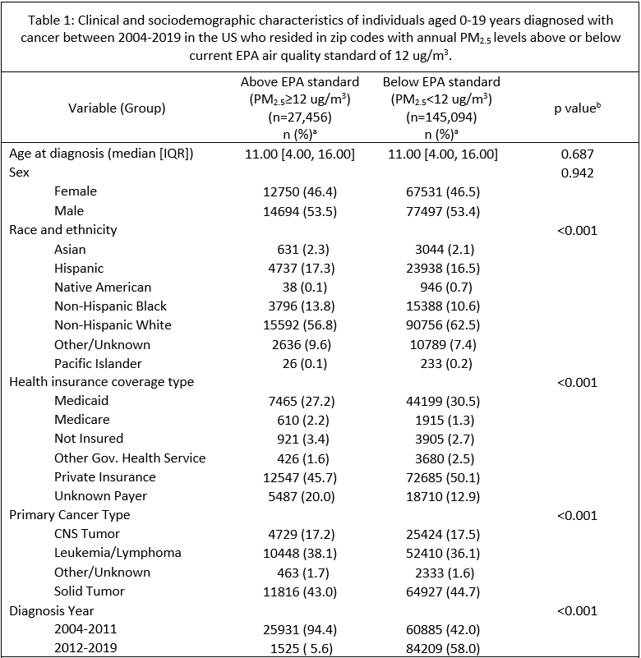
Results
Study period: 2004 – 2019
172,550 children and young adults (age 0-19 at time of diagnosis)
28,322 (16.4%) deaths
Median follow-up time 56 months

Slide 39
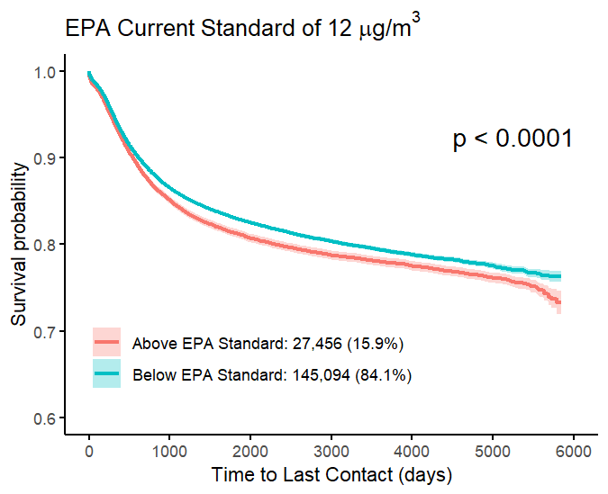
Results

Slide 40
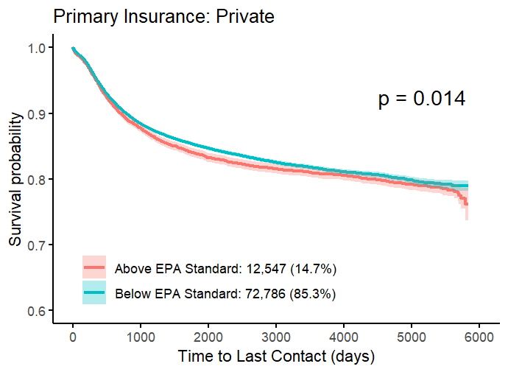
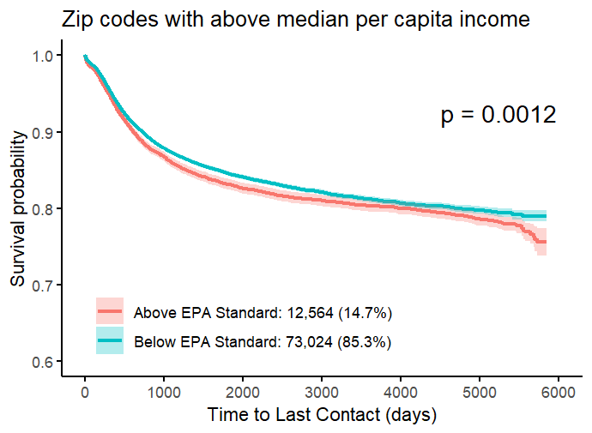
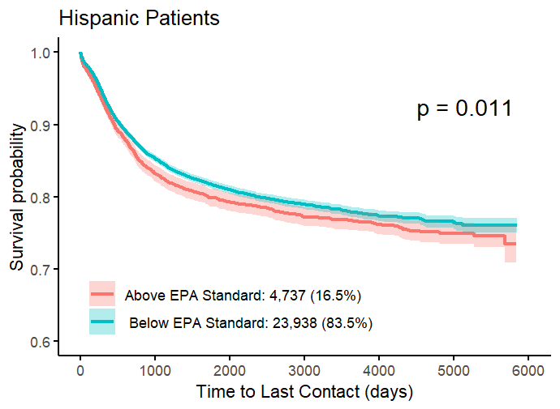
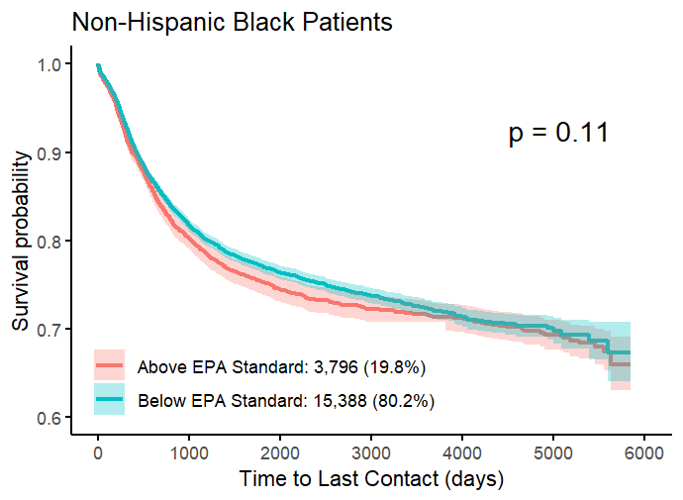
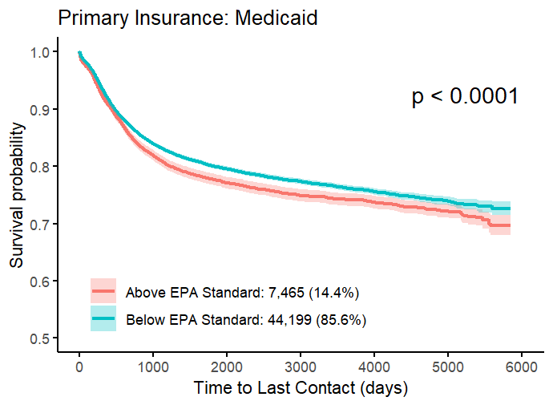
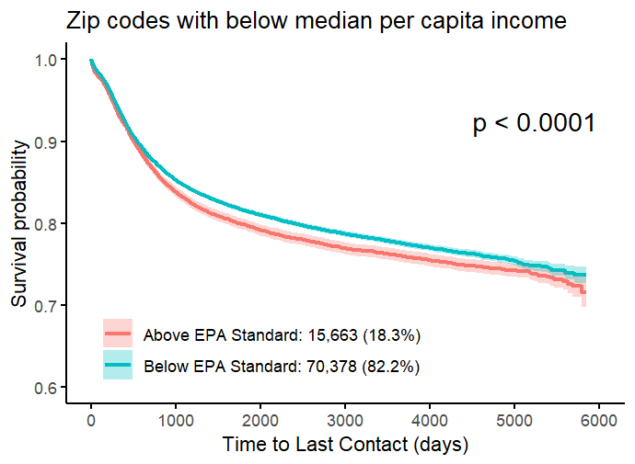
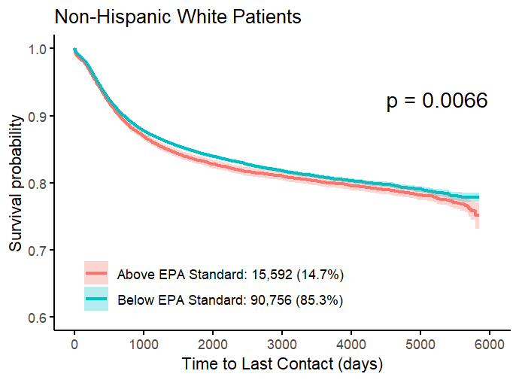
Results – subgroup analyses
Kaplan-Meier survival curves, by sociodemographic characteristics.
Figure displays Kaplan-Meier survival curves. Patients analyzed by PM_{2.5} category, in which patients were grouped based on the annual PM_{2.5} level of their home zip code the year of their diagnosis, either above or below the Environmental Protection Agency (EPA) Standard for annual PM_{2.5} levels of 12 µg/m³. Numbers (%) shown in each graph refer to number of patients (%) in each group.

Slide 41
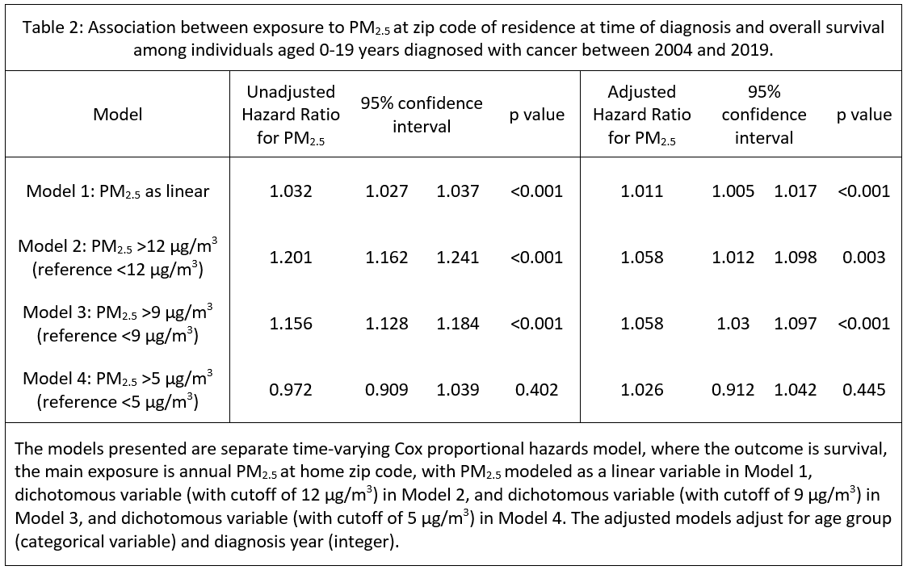
Results of Cox proportional hazards model
Notes:
the hazard ratio of 1.06 means that at any given point in time, assuming other factors are constant, individuals living in high pollution areas have a 6% higher risk of dying compared to those in low pollution areas

Slide 42
Summary of findings
PM_{2.5} concentrations, at an individual’s home zip code at time of diagnosis, are associated with worse overall survival in children with cancer.

Slide 43
In conclusion

Slide 44
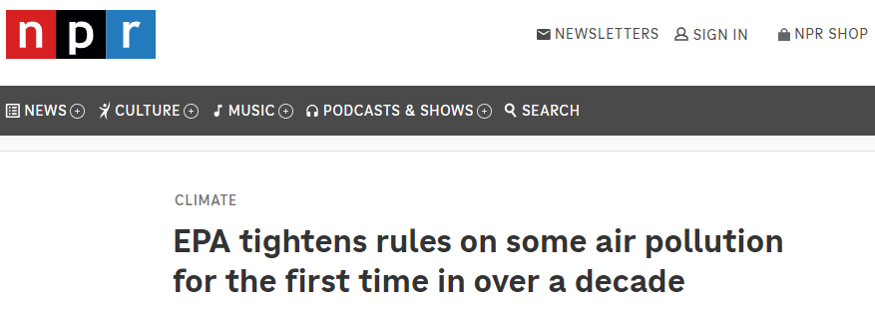
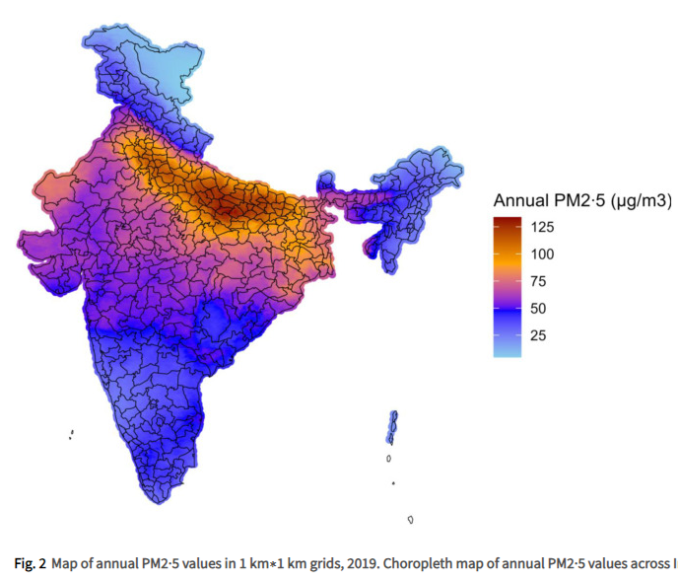
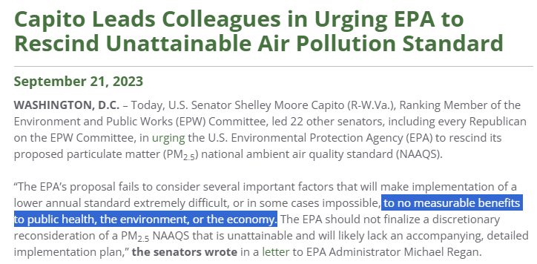
Why does this matter?

Slide 45
Thank you!
CHOA mentors along the way
Dr. Bill Woods, Dr. Joseph Lipscomb, Dr. Stefanie Ebelt, Dr. Peter Lane, Dr. Wilbur Lam, Dr. Staci Arnold, Dr. Jay Shah, Dr. David Howard, Dr. Ben Kopp, Dr. Tamara Miller, Dr. Sharon Castellino
Funding support
T32-HL139443-3
Warshaw Fellow Research Award (CHOA)
HERCULES Exposome Research Center Pilot Grant
Emory Global Health Institute Field Scholars Award
Aflac Cancer and Blood Disorders Center
I’d love to take any questions / comments / feedback

Slide 46
Thank you!
Questions / comments / feedback?

Slide 47
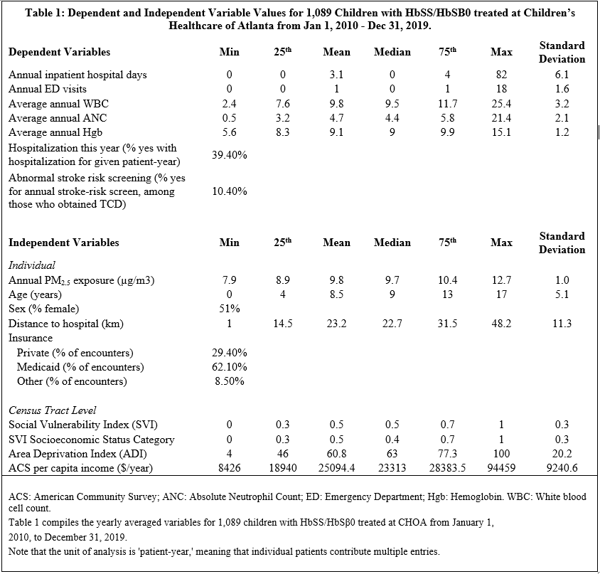

Slide 48
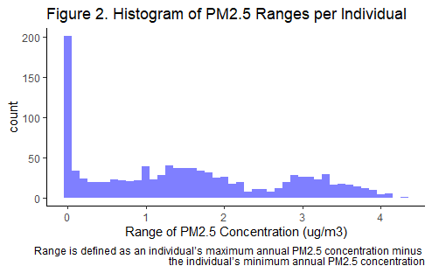
Variation in exposure
Individual PM_{2.5} variation for the cohort

Slide 49
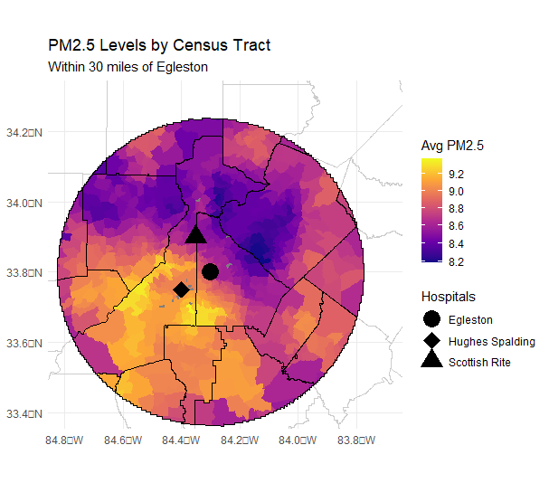
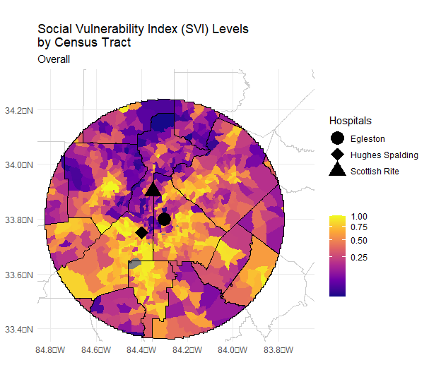
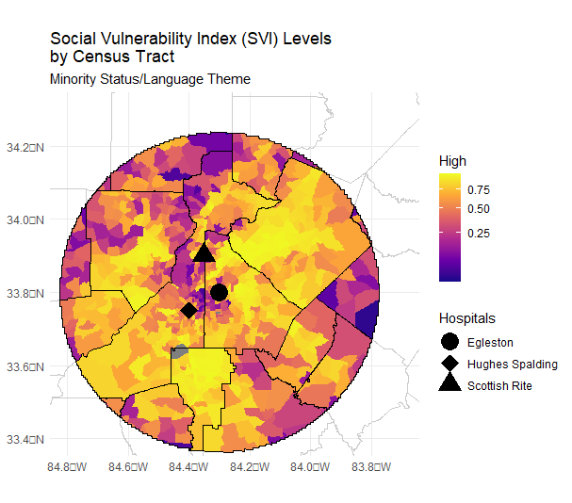
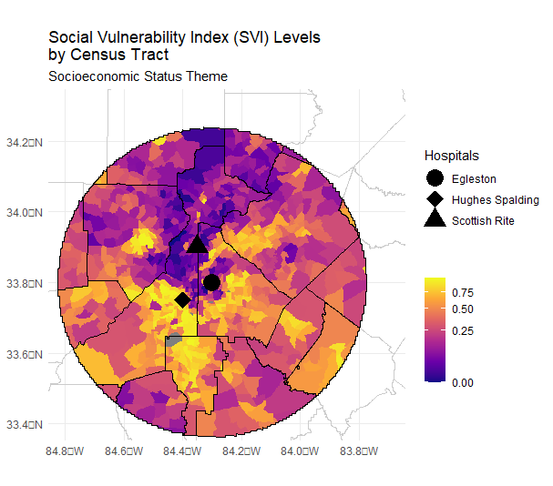
Yellow = higher vulnerability
Blue = lower vulnerability

Slide 50
Recent Accomplishments
George PE, Thakkar N, Yasobant S, Saxena D, Shah J. Impact of ambient air pollution and socio-environmental factors on the health of children younger than 5 years in India: a population-based analysis. The Lancet Regional Health - Southeast Asia. 2024; 20.
George PE, Howard DH. Nonoperative management in acute, uncomplicated appendicitis. Surgery. 2024 Feb 18.
George PE, DeGroote NP, Henderson M, Jordan K, Ziworitin-Ogola C, Castellino SM, et al. Missing the mark? Exploratory analysis of the 10-year-old cutoff as an independent marker of high-risk disease in pediatric B-ALL. Pediatric Blood & Cancer. 2024;71(3):e30825.
George PE, Maillis A, Zhu Y, Liu Y, Lane PA, Lam W, et al. Are children with sickle cell disease at particular risk from the harmful effects of air pollution? Evidence from a large, urban/peri-urban cohort. Pediatric Blood & Cancer. 2023 May 29;e30453.
George PE, Kc D, Greenleaf M, Shah J, Lam WA, Hawkins CM. Bridging the Divide: Unintended Consequences of the Shift to Home-based Telemedicine. The Journal of Pediatrics. 2023 Sep 3;113719.

